Slide 1

Object oriented programming and methodology
AL-305
PRESENTATION ON:
Dice Roller
Submitted To:
Submitted By:
Ms. Rashmi Pandey
Assistant Professor
CSE Department
Ayush Agrawal
0905AL231019
AIML 3rd sem

Slide 2
Index
Introduction
Abstract
Features
Flow of Project
Uses
Technologies used
References

Slide 3
What is a Dice Roller?
Here’s the updated text for your first slide:
A Dice Roller A digital tool that simulates the rolling of dice.
It is widely used in:
Games: Enhances gameplay in board games, role-playing games, and online games.
Education: Teaches concepts like probability, randomness, and decision-making.
Simulations: Models random events for training and research purposes.
Title: Introduction to Continuous Probability Distributions
Content:
Definition: Continuous probability distributions describe the likelihood of all possible outcomes within a continuous range.
Examples include the normal distribution, exponential distribution, and uniform distribution.

Slide 4
Abstract of the project
Dice are used in many games, and often in fairly complex ways that make it difficult to unambiguously describe the dice-roll mechanism in plain language.
Many role-playing games, such as Dungeons & Dragons, use a formalised notation for some instances of dice-rolls. This notation, once explained, make dice-roll descriptions concise and unambiguous. Furthermore, the notation has been used in automated tools for pseudo-random dice-rolling .
This notation is, however, fairly limited in the types of dice-rolls it can describe, so most games still use natural language to describe rolls. Even Dungeons & Dragons use formal notation only for some of the dice-roll methods used in the game.
Hence, a more complete notation is in this paper proposed, and a tool for pseudo-random rolls and (nearly) exact probability calculations is described. The notation is called “Troll”, combining the initial of the Danish word for dice(“terninger”) with the English word “roll”. In this report we will tell the roles and members.

Slide 5

Features of a Dice Roller
- Simulates different types of dice (D6, D20, etc.)
- Allows multiple rolls at once
- Displays results instantly
- Simple and user-friendly interface

Slide 6
How Does It Work?
1. Select the type and number of dice.
2. Click the 'Roll' button.
3. View the rolled numbers and total score.

Slide 7
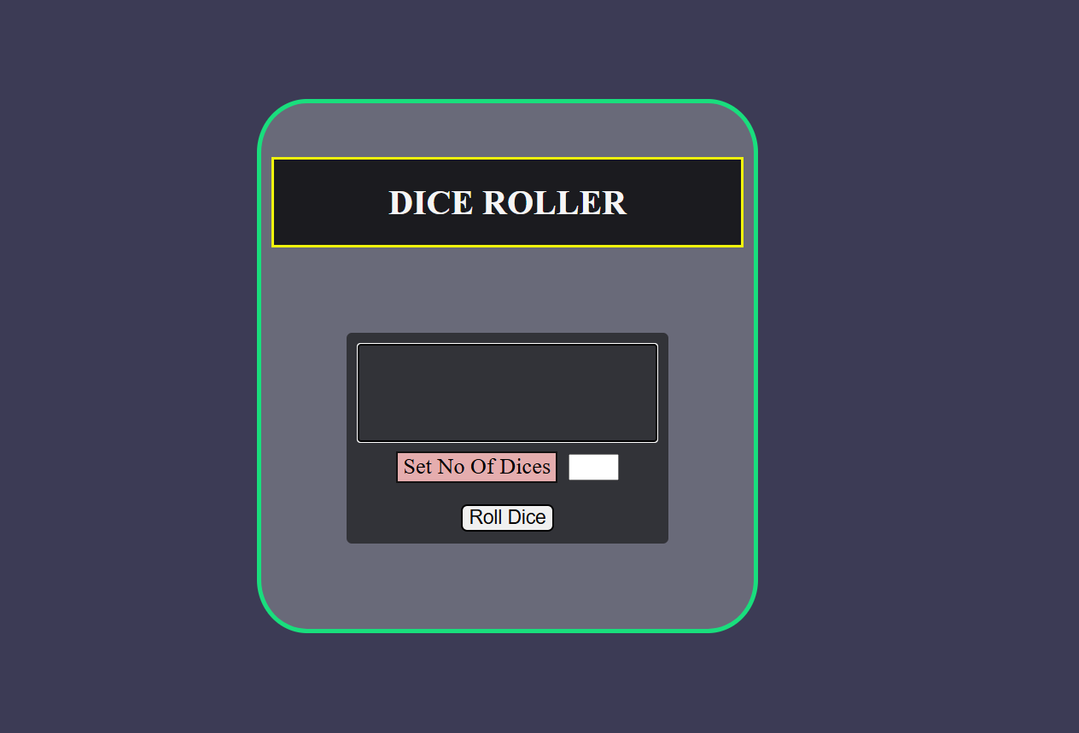
This is the landing page

Slide 8
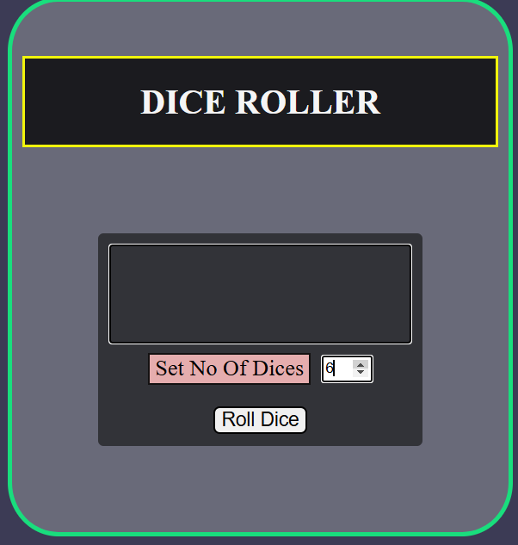
Insert the no of dices and click roll dice

Slide 9
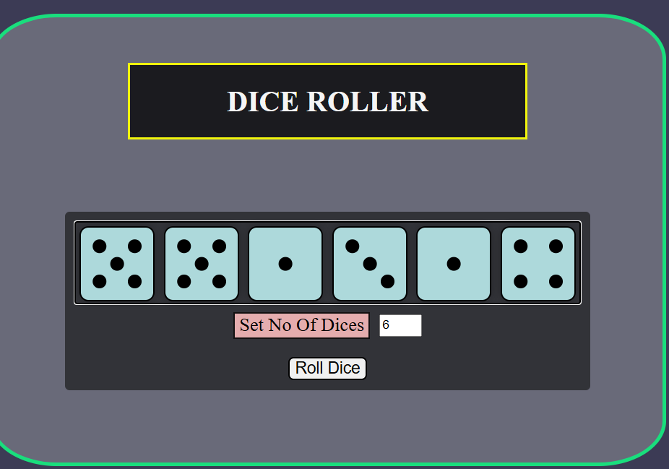
This is the output of the dices rolled

Slide 10
Uses of a Dice Roller
Gaming: Board games, RPGs, and online multiplayer games
- Education: Teaching probability and randomness
- Simulations: Modeling random events in business and science
- Programming Practice: Learning coding with simple projects
- Decision Making: Fun, random choices
- Convenience: Portable and always accessible

Slide 11
Technologies Used
1. HTML: Provides the structure and layout of the dice roller interface.
2. CSS: Styles the interface to make it visually appealing and user-friendly.
3. JavaScript: Powers the functionality, such as rolling dice, generating random numbers, and displaying results.

Slide 12
References
Open ai
Code with harry
Greek for Greeks

Slide 13


